Slide 1


SUE/RELU Workshop
Knowledge Exchange Practices in SUE
Annabel Cooper, ISSUES
www.urbansustainabilityexchange.org

Slide 2
ISSUES: Understanding the KE Landscape
Knowledge Exchange practices in SUE
Knowledge Exchange undertaken by ISSUES
Taking KE forward

Slide 3
ISSUES: Understanding the KE Landscape
Knowledge Exchange practices in SUE
Knowledge Exchange undertaken by ISSUES
Taking KE forward

Slide 4
“The aim of the ISSUES team is to ensure that the value of the research work carried out by the SUE consortia is understood, appreciated and used by practitioners and other end-users”

Slide 5
ISSUES: Understanding the KE Landscape
Understanding the perspectives of the SUE researchers in relation to KE
  Understanding types of outputs generated by SUE
    Understanding the needs and perspectives of practitioners & policy makers in relation to acquisition of new knowledge

Slide 6

Understanding the perspectives of the SUE researchers
How?
face to face discussions with the Principal Investigators to explore knowledge transfer issues using the experience of SUE PI's and their researchers.
  hosted events in September 2007 and November 2008 to enable researchers to exchange their views and experience of good practice in research dissemination
    case studies of KT Practice at a consortia level to build KT Maps

Slide 7


Improving KE through the whole research cycle

Slide 8
ISSUES: Understanding the KE Landscape
Understanding the perspectives of the SUE researchers in relation to KE
Understanding types of outputs generated by SUE
Understanding the needs and perspectives of practitioners & policy makers in relation to acquisition of new knowledge

Slide 9
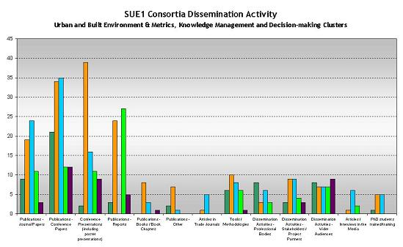
Understanding types of outputs generated by SUE
compiled, summarised and categorized all outputs from SUE 1 consortia and ongoing outputs from SUE 2
  categorised spread of dissemination activities undertaken by consortia, and their distribution across the spectrum from ‘academic-oriented’ to ‘practitioner and policy-maker oriented’.

Slide 10
Understanding types of outputs generated by SUE
compiled, summarised and categorized all outputs from SUE 1 consortia and ongoing outputs from SUE 2
  categorised spread of dissemination activities undertaken by consortia, and their distribution across the spectrum from ‘academic-oriented’ to ‘practitioner and policy-maker oriented’.
    produced distilled summaries of the outputs from completed SUE Consortia.
      Created short articles about each and published in trade/public policy press/newsletters etc. (see scrap book)

Slide 11

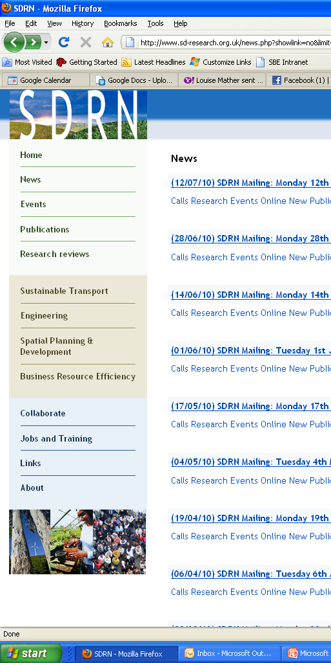
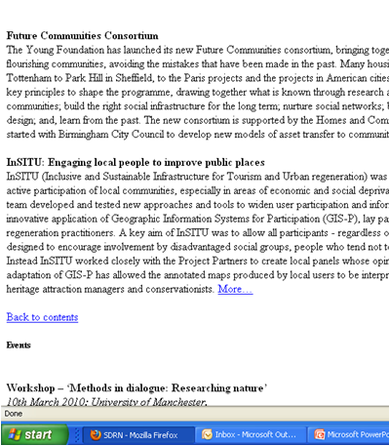

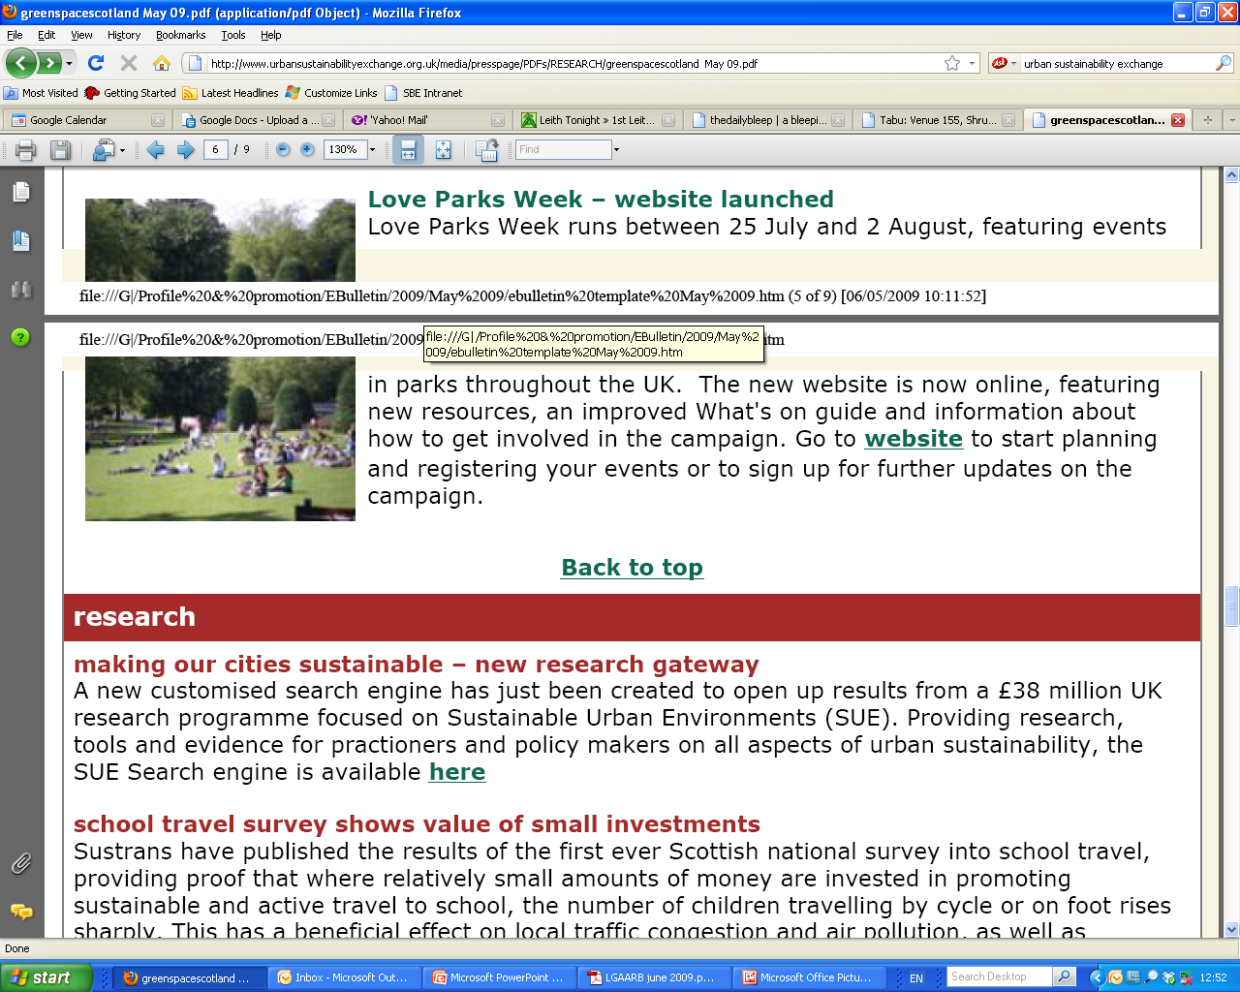
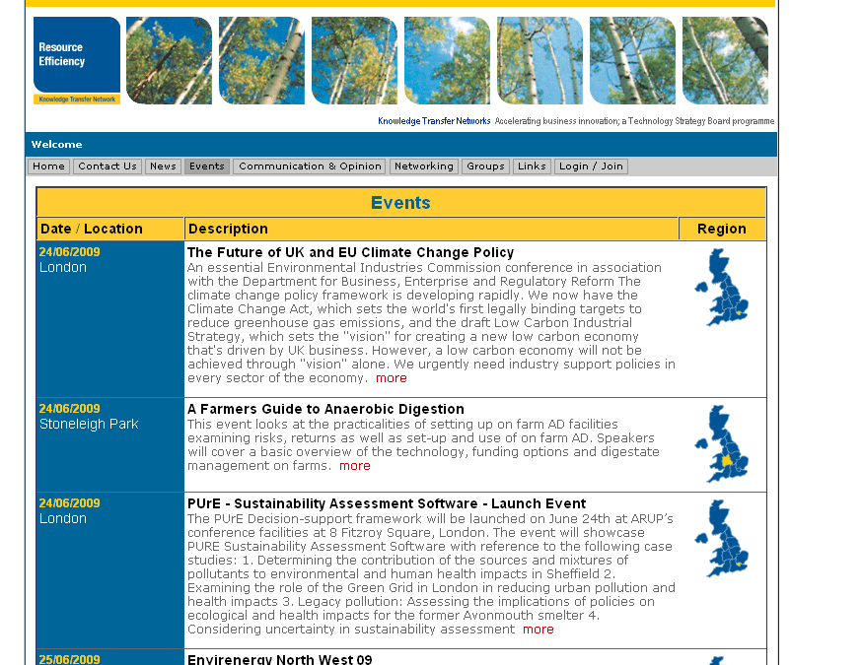
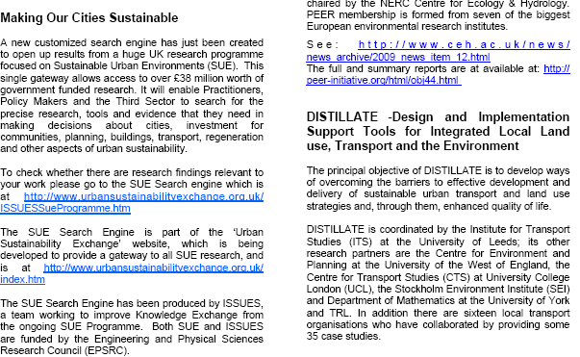
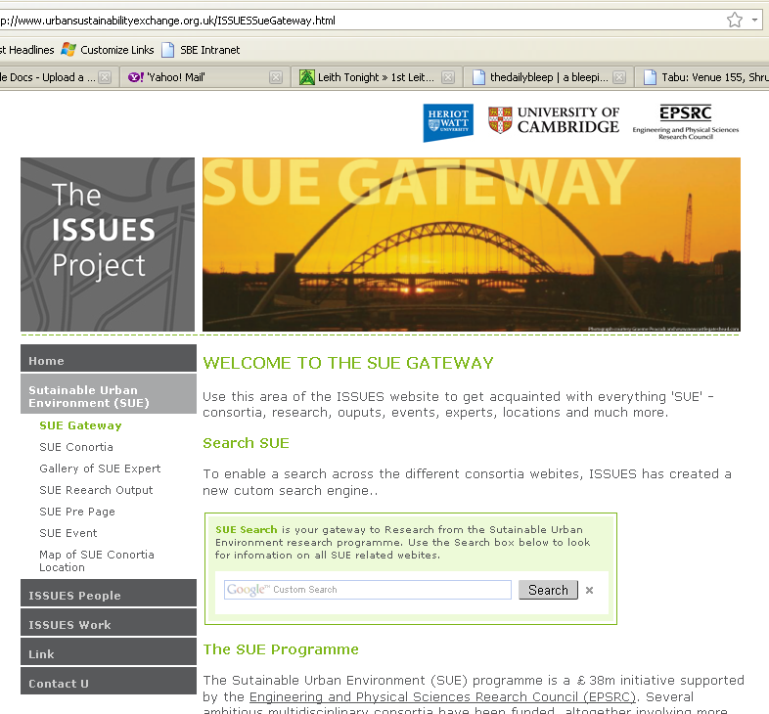
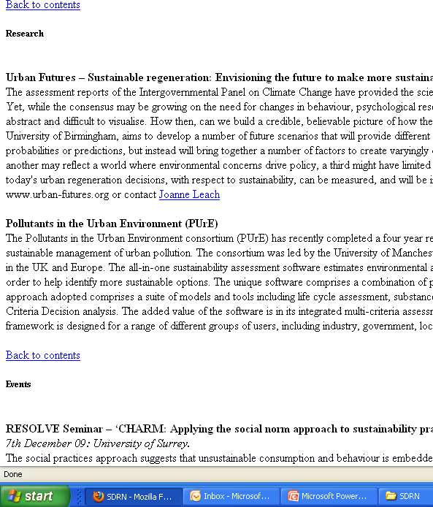

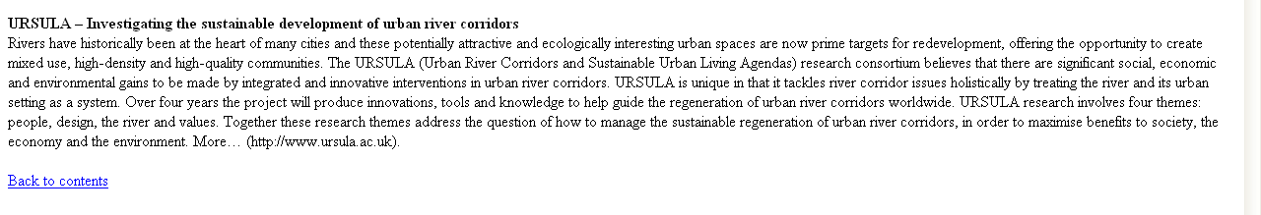
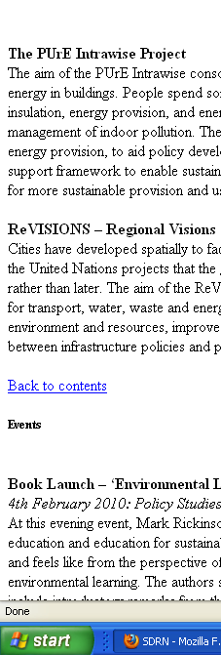
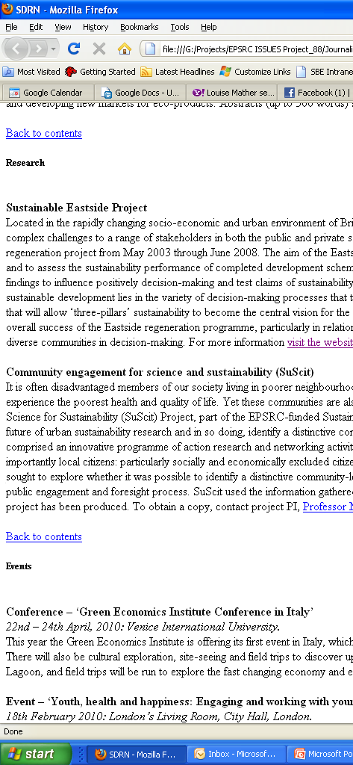




Slide 12
ISSUES: Understanding the KE Landscape
Understanding the perspectives of the SUE researchers in relation to KE
Understanding types of outputs generated by SUE
Understanding the needs and perspectives of practitioners & policy makers in relation to acquisition of new knowledge

Slide 13
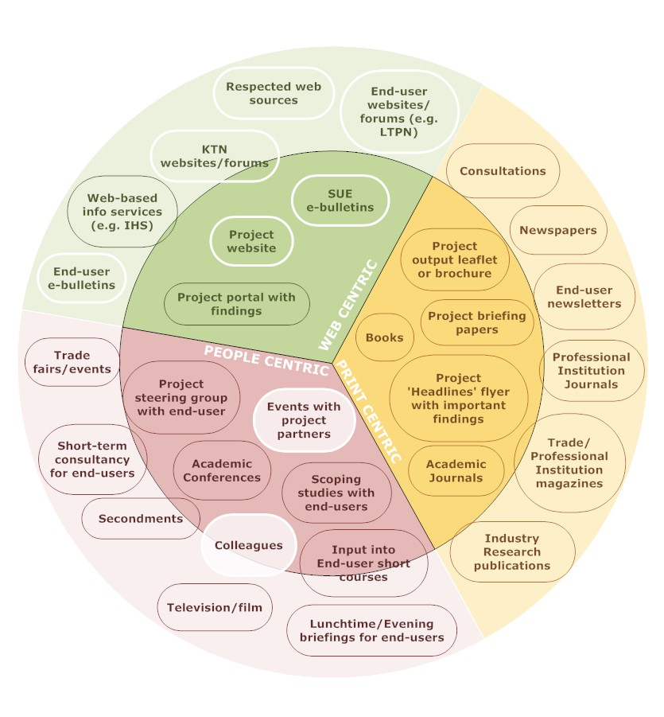
KE Landscape
Websites
Email bulletins
Personal contacts

Slide 14

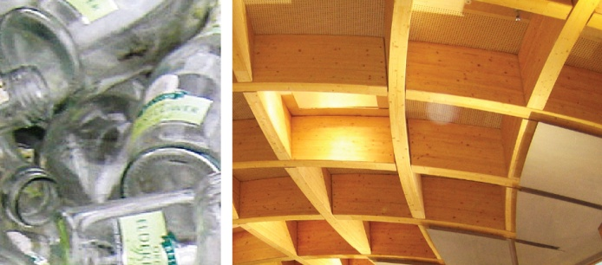
Industry preferred methods compared to
SUE dissemination methods
Trade Magazines, Professional Journals
Research Journals, Books, Conferences
Notes:
14

Slide 15
ISSUES: Understanding the KE Landscape
Knowledge Exchange practices in SUE
Knowledge Exchange undertaken by ISSUES
What next: SUE 3…SUE Legacy?

Slide 16
SUE Success stories
Building relationships
Sending a message
Designed for KE

Slide 17



Success stories – Building relationships
Urban futures:
Outcome: Incorporation of cutting edge research into the sustainability strategy of CH2M
Mechanism: Involvement of the steering group from an early stage of the project
Notes:
.

Slide 18


Success stories – Sending a Message
SUBR:IM :
Outcome: Increased end user audience
Mechanism: Signposting research through CL:AIRE

Slide 19

Success stories – Designed for KE
AMELIA (AUNT SUE)
Outcome: Uptake and use of tool by LA
Mechanism: Strong relationship between research and LA groups built into project framework

Slide 20
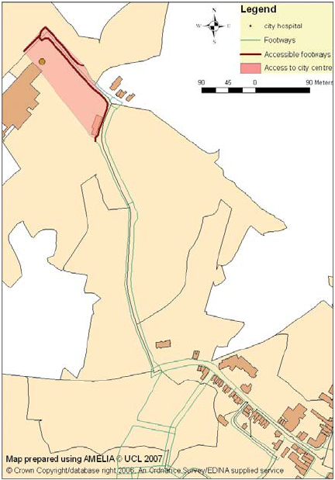
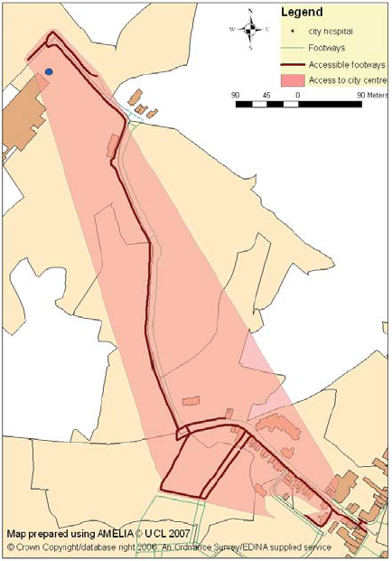
AMELIA– Designed for KE
Accessibility before and after the scheme
Maps published in: Hertfordshire Annual Progress Report 2008

Slide 21
SUE Success stories
Building relationships
Sending a message
Designed for KE

Slide 22
ISSUES: Understanding the KE Landscape
Knowledge Exchange practices in SUE
Knowledge Exchange undertaken by ISSUES
Knowledge Exchange for Impact

Slide 23
Knowledge Exchange undertaken by ISSUES
Website: SUE Gallery and Gateway
SUE Press: Scrap Book
Vidiowiki
Brave New City: events and exhibition
Targeting external events
Face to face meeting with policy makers

Slide 24
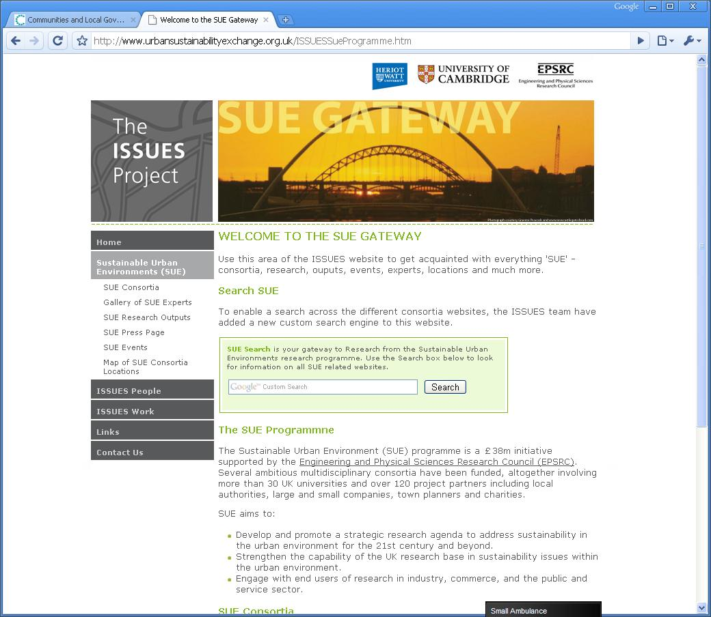
Website: SUE Gallery and Gateway

Slide 25
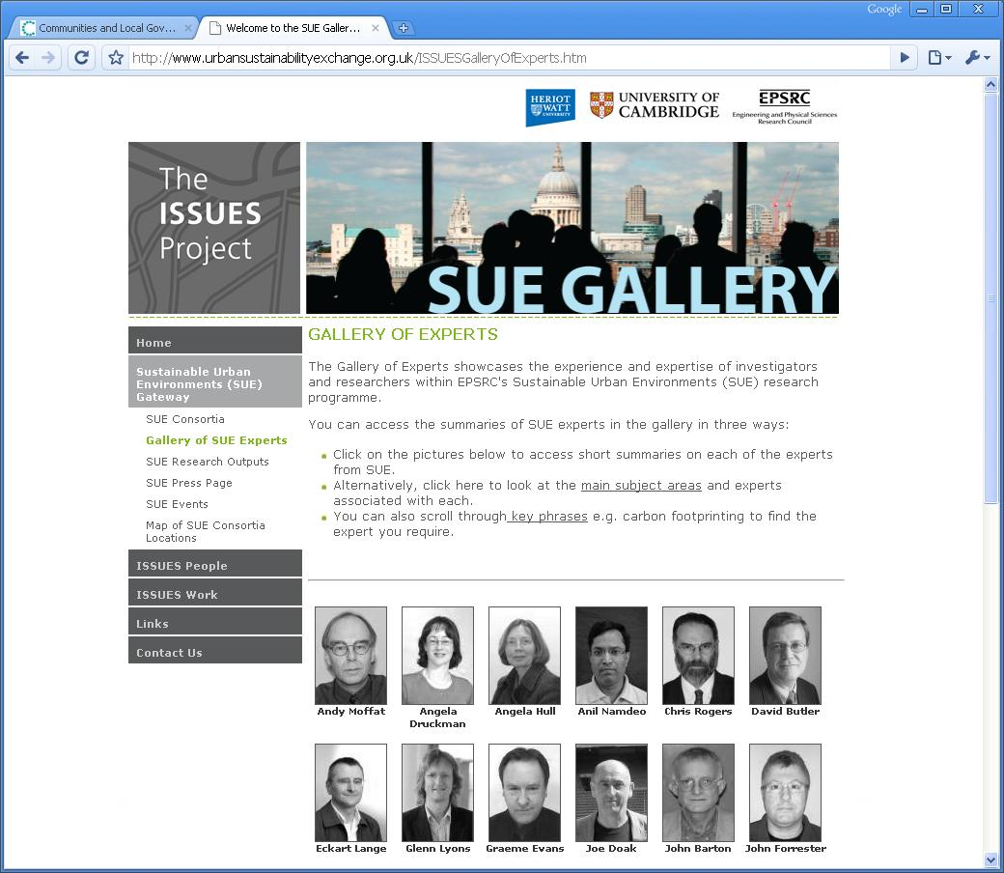

Slide 26
SUE Press: Scrap Book

Slide 27
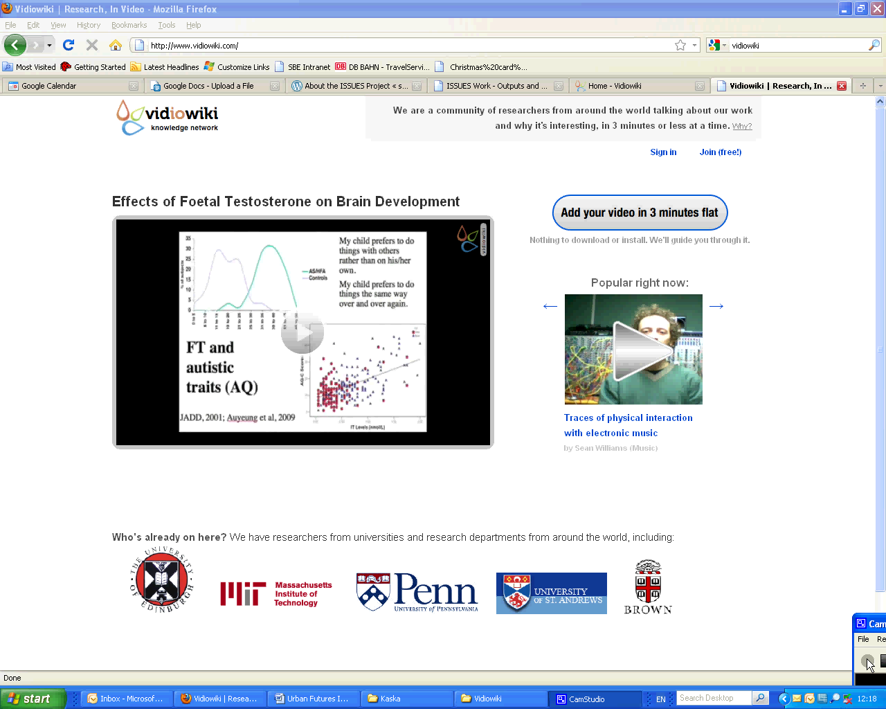
Vidiowiki

Slide 28
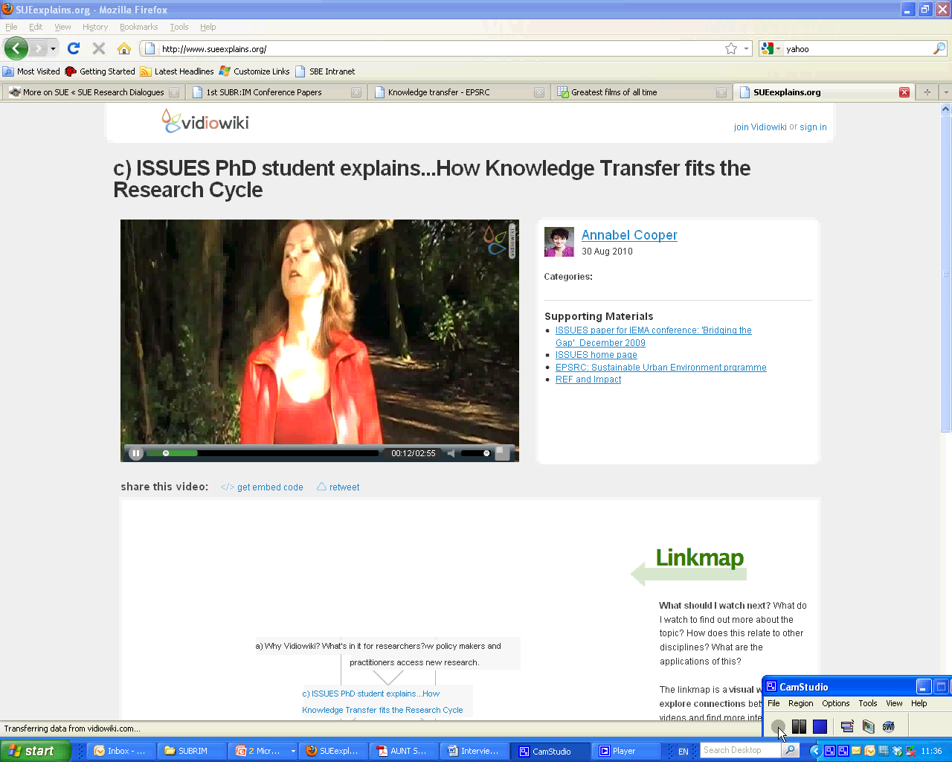
www.SUEexplains.org

Slide 29
ISSUES: Understanding the KE Landscape
Knowledge Exchange practices in SUE
Knowledge Exchange undertaken by ISSUES
Knowledge Exchange for Impact

Slide 30
Knowledge Exchange for Impact
Building relationships
Sending a message
Designed for KE
Notes:
Look back at some of the success stories from SUE and instances where impact was achieved.
RELU: attempting to capture both longer and shorter term effects through a new tool called the Stakeholder Impact Analysis Matrix (SIAM)
Asking Pis to tell RELU about the impact of their research on stakeholders and the impact the stakeholders had on research.
RCUK – Pathways to Impact
By continuing to capture and share the success stories from across the SUE Programme, lessons can be learned and taken forward to SUE 3 and 3 and 5….

Slide 31
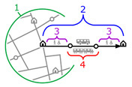
Knowledge Exchange for Impact
Building relationships
Sending a message
Designed for KE

